Slide 1
Instruction Set
Computer Architecture
Lecture 3

Slide 2
Introduction
To command a computer’s hardware, you must speak its language.
The words of a computer’s language are called instructions, and its vocabulary is called an instruction set.
The chosen instruction set comes from MIPS Technologies, which is an elegant example of the instruction sets designed since the 1980s.
MIPS (Microprocessor without Interlocked Pipeline Stages) is a reduced instruction set computer (RISC) instruction set architecture (ISA) developed by MIPS Technologies.

Slide 3
A Basic MIPS Instruction
Every computer must be able to perform arithmetic.
C code: a= b + c ;
The MIPS assembly language notation
      add a, b, c
      instructs a computer to add the two variables b and c and to put their sum in a.
This notation is rigid in that each MIPS arithmetic instruction performs only one operation and must always have exactly three variables.
Machine code: (hardware-friendly machine instructions)
00000010001100100100000000100000

Slide 4
Example 1
Translate the following C code into assembly code:
a = b + c + d + e;
add a, b, c add a, b, c
add a, a, d or add f, d, e
add a, a, e add a, a, f
Instructions are simple: fixed number of operands (unlike C)
A single line of C code is converted into multiple lines of assembly code
Some sequences are better than others… the second Sequence needs one more (temporary) variable f

Slide 5
Example 2
C code f = (g + h) – (i + j);
Assembly code translation with only add and sub instructions:
add t0, g, h add f, g, h
add t1, i, j or sub f, f, i
sub f, t0, t1 sub f, f, j

Slide 6
Registers
In C, each “variable” is a location in memory
Unlike programs in high-level languages, the operands of arithmetic instructions are restricted; they must be from a limited number of special locations built directly in hardware called registers.
To simplify the instructions, we require that each instruction (add, sub) only operate on registers
One major difference between the variables of a programming language and registers is the limited number of registers, typically 32 on current computers, like MIPS.

Slide 7
Registers-Cont.
Each register is 32-bit wide (modern 64-bit architectures have 64-bit wide registers)
A 32-bit entity (4 bytes) is referred to as a word
Although we could simply write instructions using numbers for registers, from 0 to 31, the MIPS convention is to use two-character names following a dollar sign to represent a register.
we will use $s0, $s1, . . . for registers that correspond to variables in C and Java programs and $t0, $t1, . . . for temporary registers needed to compile the program into MIPS instructions.

Slide 8
Example 3
C code f = (g + h) – (i + j);
The variables f, g, h, i, and j are assigned to the registers $s0, $s1, $s2, $s3, and $s4, respectively.
        add $t0,$s1,$s2
        add $t1,$s3,$s4
        sub $s0,$t0,$t1

Slide 9
Memory Operands
The processor can keep only a small amount of data in registers, but computer memory contains billions of data elements.
Hence, data structures (arrays and structures) are kept in memory.
Arithmetic operations occur only on registers in MIPS instructions; thus, MIPS must include instructions that transfer data between memory and registers.
Such instructions are called data transfer instructions.

Slide 10
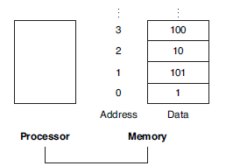
Memory Operands-Cont.
To access a word in memory, the instruction must supply the memory address. Memory is just a large, single-dimensional array, with the address acting as the index to that array, starting at 0.
For example, in Figure, the address of the third data element is 2, and the value of Memory[2] is 10.

Slide 11
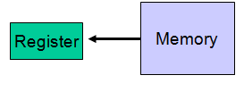
Memory Operands-Cont.
The data transfer instruction that copies data from memory to a register is traditionally called load
lw $t0, memory-address
The format of the load instruction is the name of the operation followed by the register to be loaded, then a constant and register used to access memory.
The sum of the constant portion of the instruction and the contents of the second register forms the memory address.

Slide 12
Memory Operands-Cont.
Let’s assume that A is an array of 100 words and that the compiler has associated the variables g and h with the registers $s1 and $s2.
Let’s also assume that the starting address, or base address, of the array is in $s3. Compile this C assignment statement:
g = h + A[8];
Although there is a single operation in this assignment statement, one of the operands is in memory, so we must first transfer A[8] to a register.
The address of this array element is the sum of the base of the array A, found in register $s3, plus the number to select element 8.
The data should be placed in a temporary register for use in the next instruction.

Slide 13
Memory Operands-Cont.
C Code: g = h + A[8];
Assembly Code Translation:
lw $t0,8($s3)
add $s1,$s2,$t0
The constant in a data transfer instruction (8) is called the offset, and the register added to form the address ($s3) is called the base register.

Slide 14
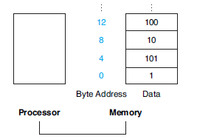
Memory Operands-Cont.
Since 8-bit bytes are useful in many programs, most architectures address individual bytes.
Therefore, the address of a word matches the address of one of the 4 bytes within the word, and addresses of sequential words differ by 4.

Slide 15
Memory Operands-Cont.
In MIPS, words must start at addresses that are multiples of 4. This requirement is called an alignment restriction, and many architectures have it.
Byte addressing also affects the array index. To get the proper byte address in the code above, the offset to be added to the base register $s3 must be 4 × 8, or 32, so that the load address will select A[8] and not A[8/4].

Slide 16
Memory Operands-Cont.
The instruction complementary to load is traditionally called store; it copies data from a register to memory.
The format of a store is similar to that of a load: the name of the operation, followed by the register to be stored, then offset to select the array element, and finally the base register.
Once again, the MIPS address is specified in part by a constant and in part by the contents of a register.
The actual MIPS name is sw, standing for store word.

Slide 17
Example
Assume variable h is associated with register $s2 and the base address of the array A is in $s3. What is the MIPS assembly code for the C assignment statement below?
A[12] = h + A[8];
Answer
lw $t0,32($s3)
add $t0,$s2,$t0
sw $t0,48($s3)

Slide 18
Constant or Immediate Operands
An instruction may require a constant as input
An immediate instruction uses a constant number as one of the inputs (instead of a register operand)
To add 4 to register $s3, we just write
addi $s3,$s3,4

Slide 19
Example
Convert to assembly:
C code: d[3] = d[2] + a;
Assembly:
lw $t0, 8($s4) # d[2] is brought into $t0
addi $t0, $t0, a # the sum is in $t0
sw $t0, 12($s4) # $t0 is stored into d[3]
Assembly version of the code continues to expand!

Slide 20
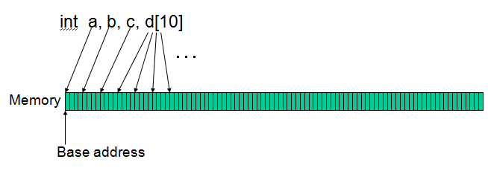
Example
addi $s0, $zero, 1000 # the program has base address
# 1000 and this is saved in $s0
# $zero is a register that always
# equals zero
addi $s1, $s0, 0 # this is the address of variable a
addi $s2, $s0, 4 # this is the address of variable b
addi $s3, $s0, 8 # this is the address of variable c
addi $s4, $s0, 12 # this is the address of variable d[0]

Slide 21
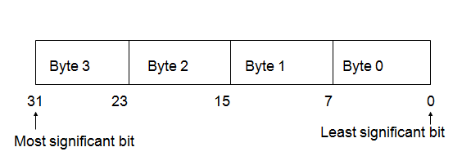
Byte Storage

Slide 22
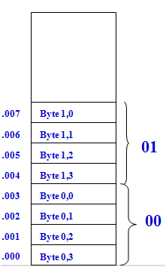
Big-Endian Storage Method
Suppose a word W_{i} is represented as B_{i, 3} B_{i, 2} B_{i, 1} B_{i, 0}
Most significant byte B_{i, 3} of W_{i} is assigned the lowest address and the least significant byte B_{i, 0} is assigned the highest address.
It is so named because it assigns highest address to byte 0 of a word.

Slide 23
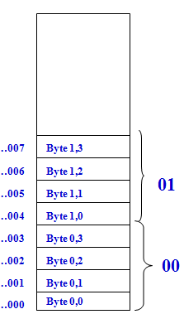
Little-Endian Storage Method
Suppose a word W_{i} is represented as B_{i, 0} B_{i, 1} B_{i, 2} B_{i, 3}
Most significant byte B_{i, 3} of W_{i} is assigned the highest address and the least significant byte B_{i, 0} is assigned the lowest address.
It is so named because it assigns lowest address to byte 0 of a word.

Slide 24
Cont.
Although the MIPS registers we discussed are 32 bits wide, there is a 4-bit version of the MIPS instruction set with 32 64-bit registers.
To keep them straight, they are officially called MIPS-32 and MIPS-64.

